Slide 1
Stock Prediction App Design
Dennis

Slide 2
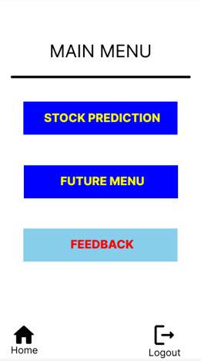
Project overview
The product:
A grocery shop in a town wants an app which is able to predict stock levels after a certain time frame.
Project duration:
June 2022 - Dec 2022

Slide 3
Project overview
The problem:
Predict stock levels in a shop for stock replenishing in advance.
The goal:
Create an app using machine learning models for shop employees .

Slide 4
Project overview
My role:
UX designer for Company ______.
Responsibilities:
Conducting interviews, paper and digital wireframing, low and high-fidelity prototyping, conducting usability studies, accounting for accessibility, and iterating on designs.

Slide 5
User research
Personas
Problem statements
User journey maps
Understanding
the user

Slide 6
User research: summary
There is a preliminary interview done with some shop employees to get what they want for their needs.
.

Slide 7
User research: pain points
1
2
3
Screen Scrolling
Confusion
Missing User Guide
Need scrolling a lot if many items entered
Menu interfaces can be confusing at times
Since the app is very new, it will be good to include a built in user guide

Slide 8
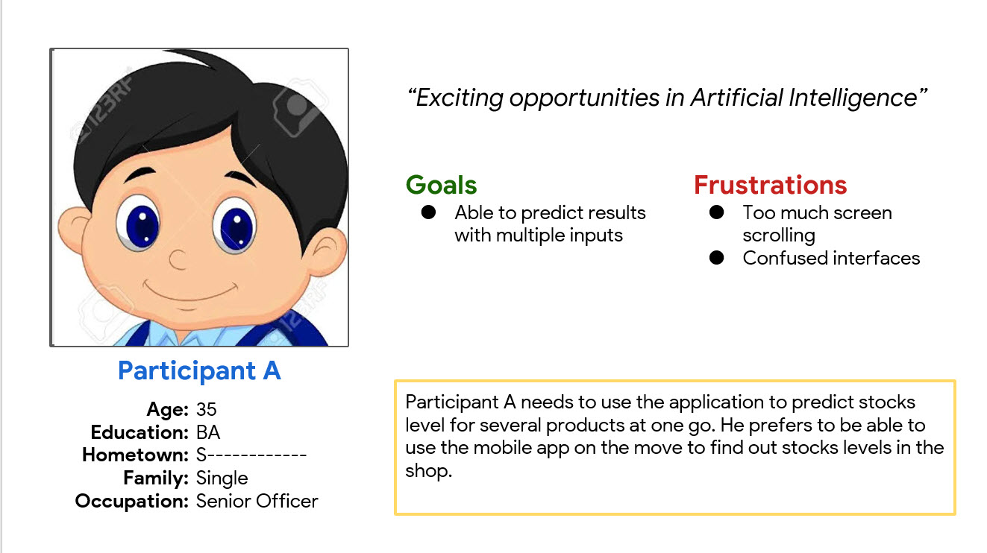
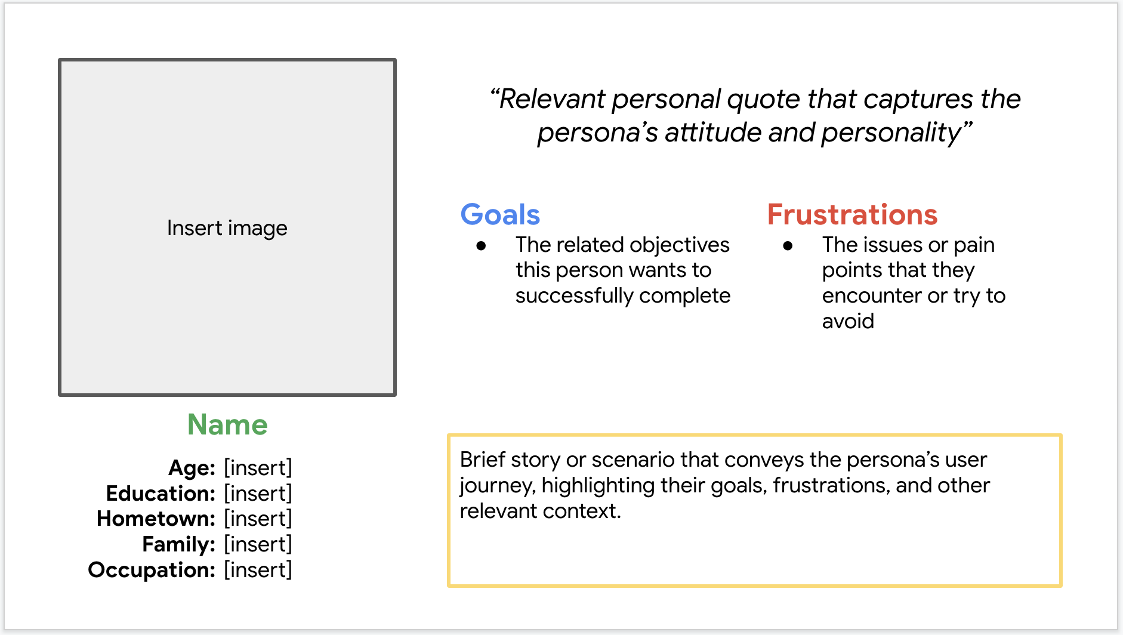
Persona: Participant A
Problem statement:
A is a senior employee
who needs to use the app on the go
because he is outside office a lot.

Slide 9
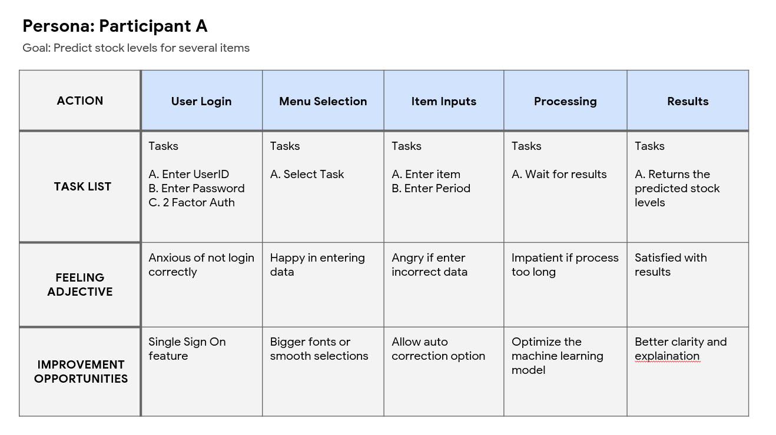
User journey map
This is how user A journey map
Image of user journey map

Slide 10
Paper wireframes
Digital wireframes
Low-fidelity prototype
Usability studies
Starting
the design

Slide 11
Paper wireframes
I did a rough logical step by step journey that the user will make. Modifications will come later after first usage study.
Image of paper wireframes including five different versions of the same screen and one image of the new, refined version

Slide 12
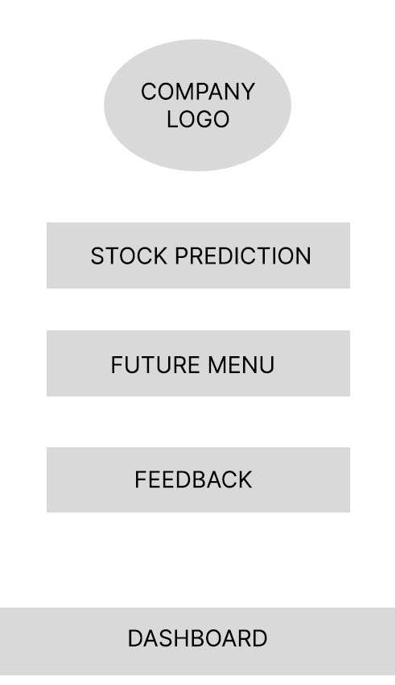
Digital wireframes
A simply layout was proposed for a quick and easy way for users to start with.
Insert first wireframe example that demonstrates design thinking aligned with user research
Simple layout
with spacing
For easy touch
Shortcuts for easy access

Slide 13
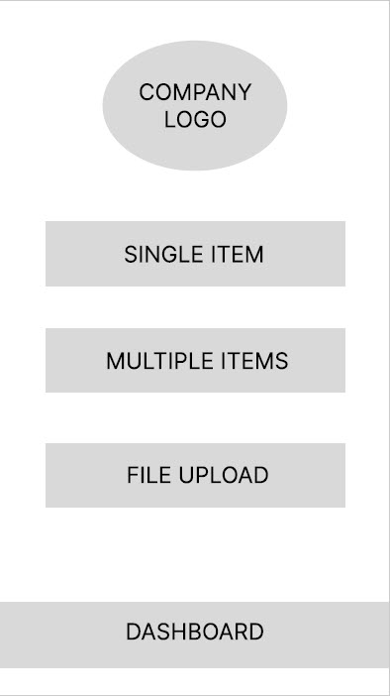
Digital wireframes
Consistency in designs
I am maintaining the same feel and look interfaces
Insert second wireframe example that demonstrates design thinking aligned with user research
Add future enhancements

Slide 14
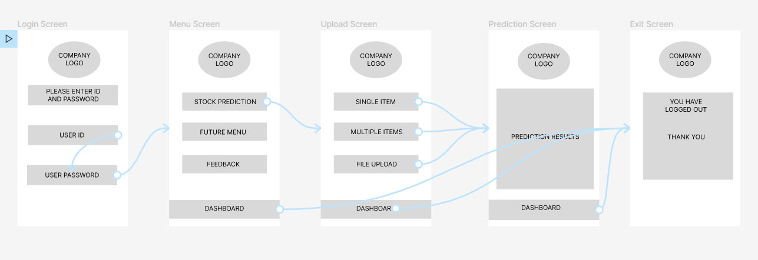
Low-fidelity prototype
This is initial low fidelity app flow.
Screenshot of prototype with connections or prototype GIF

Slide 15
Usability study: findings
Write a short introduction to the usability studies you conducted and your findings.
Round 1 findings
Round 2 findings
1
Able to use the app on the go
1
User confusion on using the app
2
Able to enter multiple stocks
2
User would like to have help menus
3
Able to contact support
3
Users has difficulty reading words

Slide 16
Refining
the design
Mockups
High-fidelity prototype
Accessibility

Slide 17
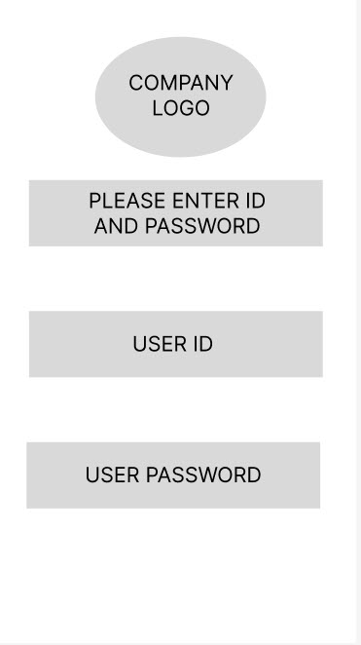
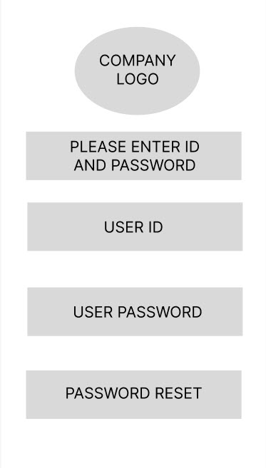
Mockups
Before usability study
After usability study
I have added the password reset options after user requested for it.
Image of selected screen before usability study
Image of selected screen after usability study

Slide 18
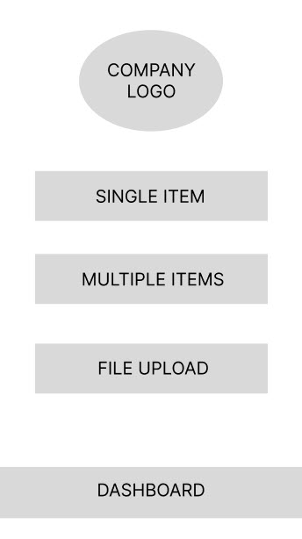
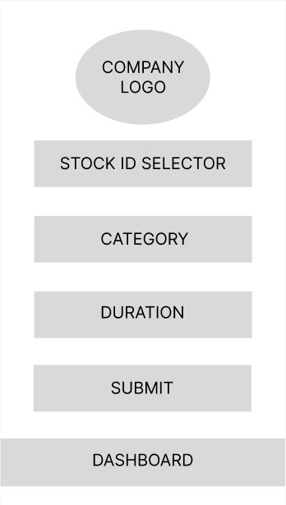
Mockups
Before usability study
After usability study
Due to user confusion, I decided to split each tasks into separate screen for clarity.
Image of selected screen before usability study
Image of selected screen after usability study

Slide 19
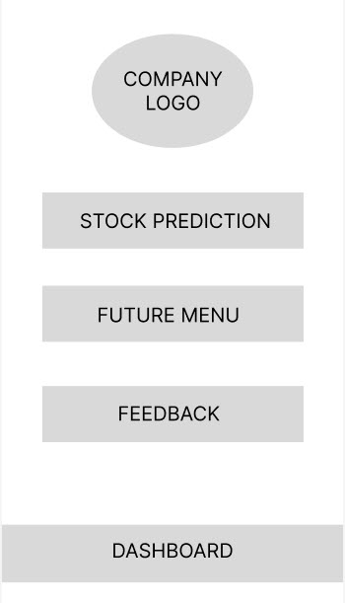
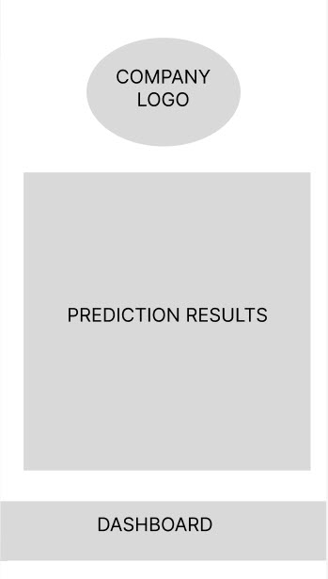
Mockups in sequence
Main mockup screen for display
Main mockup screen for display
Main mockup screen for display
Main mockup screen for display

Slide 20
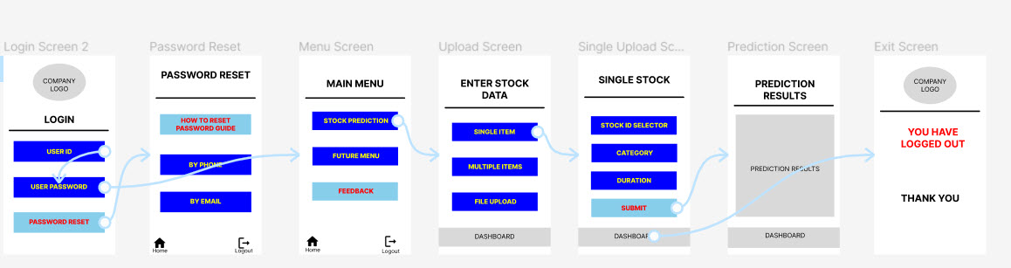
High-fidelity prototype
Screenshot of prototype with connections or prototype GIF

Slide 21
Accessibility considerations
1
2
3
Provide user settings for enlarging font sizes
Incorporate voice to text in future enhancements
Use proper lines, color and spacing for easy selection and color blind

Slide 22
Going forward
Takeaways
Next steps

Slide 23
Takeaways
Impact:
The changes and improvements made on UX designs have made the app easier to use.
What I learned:
Simple and effective changes can make a difference in user experiences.

Slide 24
Next steps
1
2
3
Stock Data Entry options to be expanded to allow users to quickly upload relevant data and get results in bulk
Accessibility and language issues to be tackled for some employees who still struggle in using the app
Offline prediction processing option to be introduced for those who are disconnected or on the move

Slide 25
Insert a few sentences summarizing the next steps you would take with this project and why. Feel free to organize next steps in a bullet point list.
Let’s connect!
Thank you very much for reviewing my work.
I am not contactable at this point. In future I will upload my work to Github as archive materials.

Slide 26
Thank you!

